Slide 1
Space-ready FPGA hardware acceleration for .NET software - Hastlayer
Zoltán Lehóczky @ Lombiq
Dávid El-Saig @Lombiq Ernő Dávid @ Wigner
GPU Day 2021 10.11.2021

Slide 2


Slide 3


Slide 4
Let’s talk about you!

Slide 5
You’re doing some number crunching.
Notes:
„What I mean is that you run some compute-bound, so CPU-bound algorithms.”

Slide 6
Number crunching like in…
Scientific computations
Artificial intelligence, machine learning
Image and video processing, computer vision
Data compression

Slide 7
To make faster you can…
Profile and optimize it
Parallelize it ️
Use faster and/or more hardware️

Slide 8
To make faster you can…
Profile and optimize it ✔️
Parallelize it ️
Use faster and/or more hardware️

Slide 9
To make faster you can…
Profile and optimize it ✔️
Parallelize it ✔️
Use faster and/or more hardware️

Slide 10
To make faster you can…
Profile and optimize it ✔️
Parallelize it ✔️
Use faster and/or more hardware ✔️

Slide 11
To make faster you can…
Profile and optimize it ✔️
Parallelize it ✔️
Use faster and/or more hardware ✔️
…

Slide 12
To make faster you can…
Profile and optimize it ✔️
Parallelize it ✔️
Use faster and/or more hardware ✔️
Use heterogeneous computing: GPUs, FPGAs… ❗

Slide 13
Let’s explore the last part a bit.

Slide 14
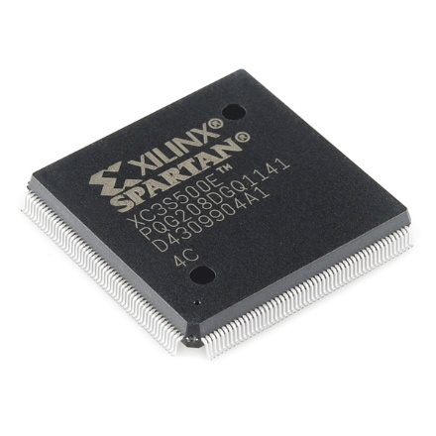
FPGAs?
Field-Programmable Gate Array
Can behave like any other chip (with limitations)
Can dynamically be „re-wired”
Image by SparkFun Electronics, Boulder, USA

Slide 15
CPU vs GPU vs FPGA

Slide 16
But!

Slide 17
What’s Hastlayer?

Slide 18
computer program → FPGA logic

Slide 19
computer program → computer chip

Slide 20
.NET (C#, VB, C++, F#, Python, PHP, JavaScript…) → FPGA logic

Slide 21
The benefits of FPGAs for us all
Performance increase for parallel compute-bound algorithms
Higher power efficiency
Still only software development

Slide 22
Demo: Hands-on Hastlayer

Slide 23
What else?

Slide 24
Xilinx Vitis support
High-performance datacenter accelerator cards
In all major cloud providers or on-premise
Aerospace industry, on board of drones and satellites (.NET in space!)

Slide 25
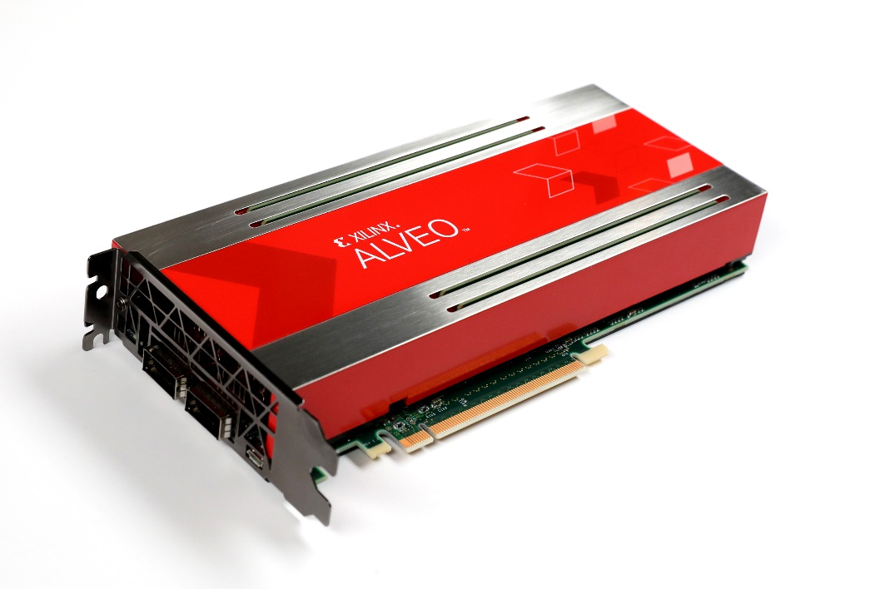
Xilinx Alveo benchmarks
Algorithm | Speed advantage | Power advantage
ImageContrastModifier | 34x | 120x
MonteCarloPiEstimator | 4x | 21x
ParallelAlgorithm | 4x | 25x
https://github.com/Lombiq/Hastlayer-SDK/blob/dev/Docs/Benchmarks.md

Slide 26
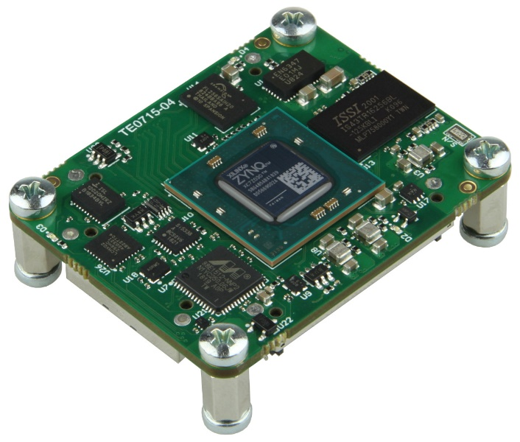
Xilinx Zynq benchmarks
Algorithm | Speed advantage | Power advantage
ImageContrastModifier | 24x | 27x
MonteCarloPiEstimator | 110x | 154x
ParallelAlgorithm | 119x | 115x
https://github.com/Lombiq/Hastlayer-SDK/blob/dev/Docs/Benchmarks.md

Slide 27
Posit number format
https://hastlayer.com/arithmetics
Better range/accuracy than IEEE float
We already have a posit „processor”

Slide 28
Wrapping up

Slide 29
I like this, how do I start?
Check out the SDK: https://github.com/Lombiq/Hastlayer-SDK/
Be ready for an FPGA-filled future!

Slide 30
Are you ready to *be* the hardware?
zoltan.lehoczky@hastlayer.com
https://hastlayer.com
https://github.com/Lombiq/Hastlayer-SDK/
https://lombiq.com

